Slide 1
CIS387/ECE387
Digital Forensics I
Digital Forensics Profession
Notes:
Guide to Computer Forensics and Investigations Fifth Edition
Chapter 1
Understanding The Digital Forensics Profession and Investigations

Slide 2
Digital Forensics and Other Related Disciplines
Investigating digital devices includes:
  Collecting data securely
  Examining suspect data to determine details such as origin and content
  Presenting digital information to courts
  Applying laws to digital device practices
Digital forensics is different from data recovery
  Which involves retrieving information that was deleted by mistake or lost during a power surge or server crash
Notes:
Digital Forensics and Other Related Disciplines
Investigating digital devices includes:
Collecting data securely
Examining suspect data to determine details such as origin and content
Presenting digital information to courts
Applying laws to digital device practices
Digital forensics is different from data recovery
Which involves retrieving information that was deleted by mistake or lost during a power surge or server crash

Slide 3
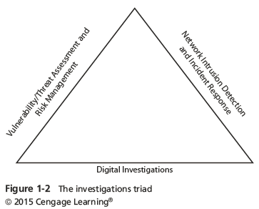
Digital Forensics and Other Related Disciplines
Forensics investigators often work as part of a team, known as the investigations triad
Notes:
Digital Forensics and Other Related Disciplines
Forensics investigators often work as part of a team, known as the investigations triad
Figure 1-2 The investigation triad

Slide 4
Digital Forensics and Other Related Disciplines
Vulnerability/threat assessment and risk management
  Tests and verifies the integrity of stand-along workstations and network servers
Network intrusion detection and incident response
  Detects intruder attacks by using automated tools and monitoring network firewall logs
Digital investigations
  Manages investigations and conducts forensics analysis of systems suspected of containing evidence
Notes:
Digital Forensics and Other Related Disciplines
Vulnerability/threat assessment and risk management
Tests and verifies the integrity of stand-along workstations and network servers
Network intrusion detection and incident response
Detects intruder attacks by using automated tools and monitoring network firewall logs
Digital investigations
Manages investigations and conducts forensics analysis of systems suspected of containing evidence

Slide 5
A Brief History of Digital Forensics
  1978 Florida Computer Crime Act, included legislation against the authorized modification or deletion of data on a computer system
  Later, laws were passed to deal with issues of copyright, privacy/harassment (cyber bullying, cyber stalking, etc.) and child pornography
The Computer Fraud and Abuse Act was passed in 1986
  Specific state laws were generally developed later
Notes:
A Brief History of Digital Forensics
By the early 1990s, the International Association of Computer Investigative Specialists (IACIS) introduced training on software for digital forensics
IRS created search-warrant programs
ASR Data created Expert Witness for Macintosh
ILook is currently maintained by the IRS Criminal Investigation Division
AccessData Forensic Toolkit (FTK) is a popular commercial product

Slide 6
A Brief History of Digital Forensics
1980s – 1990s: Growth of the field
  FBI Computer Analysis and Response Team (CART) was formed in 1984 to handle cases involving digital evidence
  By late 1990s, CART teamed up with Department of Defense Computer Forensics Laboratory (DCFL)
  Cliff Stoll investigated the hacker Markus Hess in 1986
  Ad-hoc tools and techniques were developed by hobbyist practitioners.
Notes:
A Brief History of Digital Forensics
By the early 1990s, the International Association of Computer Investigative Specialists (IACIS) introduced training on software for digital forensics
IRS created search-warrant programs
ASR Data created Expert Witness for Macintosh
ILook is currently maintained by the IRS Criminal Investigation Division
AccessData Forensic Toolkit (FTK) is a popular commercial product

Slide 7
A Brief History of Digital Forensics
2000s: Developing standards
    The paper "Best practices for Computer Forensics“ was produced by Scientific Working Group on Digital Evidence (SWGDE) by in 2002.
    Since the late 1990s, digital analysis of phones becomes more and more important
    Focus also shifted to Internet crimes.
    In October 2012, an ISO standard for digital forensics was ratified - ISO 27037 Information technology - Security techniques
Notes:
A Brief History of Digital Forensics
By the early 1990s, the International Association of Computer Investigative Specialists (IACIS) introduced training on software for digital forensics
IRS created search-warrant programs
ASR Data created Expert Witness for Macintosh
ILook is currently maintained by the IRS Criminal Investigation Division
AccessData Forensic Toolkit (FTK) is a popular commercial product

Slide 8
A Brief History of Digital Forensics
Development of forensics tools
  1990s, the International Association of Computer Investigative Specialists (IACIS) introduced training on software for digital forensics
  IRS created search-warrant programs
  ASR Data created Expert Witness for Macintosh
  ILook is currently maintained by the IRS Criminal Investigation Division
  Encase and Forensic Toolkit (FTK) are popular commercial products
Notes:
A Brief History of Digital Forensics
By the early 1990s, the International Association of Computer Investigative Specialists (IACIS) introduced training on software for digital forensics
IRS created search-warrant programs
ASR Data created Expert Witness for Macintosh
ILook is currently maintained by the IRS Criminal Investigation Division
AccessData Forensic Toolkit (FTK) is a popular commercial product

Slide 9
Fourth Amendment
The Fourth Amendment to the U.S. Constitution protects everyone’s right to be secure from search and seizure
  Separate search warrants might not be necessary for digital evidence
Every U.S. jurisdiction has case law related to the admissibility of evidence recovered from computers and other digital devices
Notes:
An Overview of Digital Forensics
The Fourth Amendment to the U.S. Constitution protects everyone’s right to be secure from search and seizure
Separate search warrants might not be necessary for digital evidence
Every U.S. jurisdiction has case law related to the admissibility of evidence recovered from computers and other digital devices

Slide 10
Understanding Case Law
Existing laws can’t keep up with the rate of technological change
When statutes don’t exist, case law is used
  Allows legal counsel to apply previous similar cases to current one in an effort to address ambiguity in laws
Examiners must be familiar with recent court rulings on search and seizure in the electronic environment
Notes:
Understanding Case Law
Existing laws can’t keep up with the rate of technological change
When statutes don’t exist, case law is used
Allows legal counsel to apply previous similar cases to current one in an effort to address ambiguity in laws
Examiners must be familiar with recent court rulings on search and seizure in the electronic environment

Slide 11
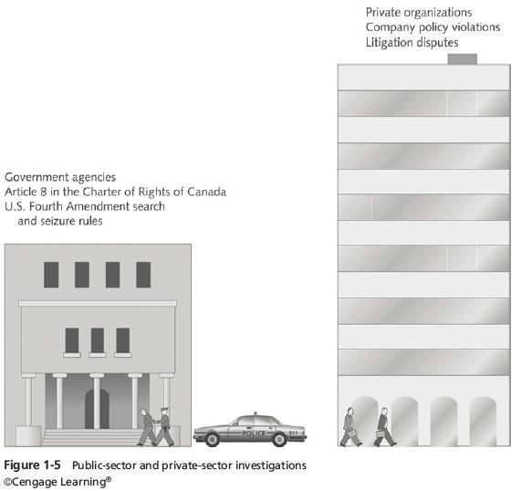
Preparing for Digital Investigations
Digital investigations fall into two categories:
  Public-sector investigations
  Private-sector investigations
Notes:
Preparing for Digital Investigations
Digital investigations fall into two categories:
Public-sector investigations
Private-sector investigations
Figure 1-5 Public-sector and private-sector investigations

Slide 12
Preparing for Digital Investigations
Public-sector investigations involve government agencies responsible for criminal investigations and prosecution
Fourth Amendment to the U.S. Constitution
  Restrict government search and seizure
The Department of Justice (DOJ) updates information on computer search and seizure regularly
Private-sector investigations focus more on policy violations
Notes:
Preparing for Digital Investigations
Public-sector investigations involve government agencies responsible for criminal investigations and prosecution
Fourth Amendment to the U.S. Constitution
Restrict government search and seizure
The Department of Justice (DOJ) updates information on computer search and seizure regularly
Private-sector investigations focus more on policy violations

Slide 13
Understanding Law Enforcement Agency Investigations
When conducting public-sector investigations, you must understand laws on computer-related crimes including:
  Standard legal processes
  Guidelines on search and seizure
  How to build a criminal case
The Computer Fraud and Abuse Act was passed in 1986
  Specific state laws were generally developed later
Notes:
Understanding Law Enforcement Agency Investigations
When conducting public-sector investigations, you must understand laws on computer-related crimes including:
Standard legal processes
Guidelines on search and seizure
How to build a criminal case
The Computer Fraud and Abuse Act was passed in 1986
Specific state laws were generally developed later

Slide 14
Following Legal Processes
A criminal investigation usually begins when someone finds evidence of or witnesses a crime
  Witness or victim makes an allegation to the police
Police interview the complainant and writes a report about the crime
Report is processed and management decides to start an investigation or log the information in a police blotter
  Blotter is a historical database of previous crimes
Notes:
Following Legal Processes
A criminal investigation usually begins when someone finds evidence of or witnesses a crime
Witness or victim makes an allegation to the police
Police interview the complainant and writes a report about the crime
Report is processed and management decides to start an investigation or log the information in a police blotter
Blotter is a historical database of previous crimes

Slide 15
Following Legal Processes
Digital Evidence First Responder (DEFR)
  Arrives on an incident scene, assesses the situation, and takes precautions to acquire and preserve evidence
Digital Evidence Specialist (DES)
  Has the skill to analyze the data and determine when another specialist should be called in to assist
Affidavit - a sworn statement of support of facts about or evidence of a crime
  Must include exhibits that support the allegation
Notes:
Following Legal Processes
Digital Evidence First Responder (DEFR)
Arrives on an incident scene, assesses the situation, and takes precautions to acquire and preserve evidence
Digital Evidence Specialist (DES)
Has the skill to analyze the data and determine when another specialist should be called in to assist
Affidavit - a sworn statement of support of facts about or evidence of a crime
Must include exhibits that support the allegation

Slide 16
Understanding Private-Sector Investigations
Private-sector investigations involve private companies and lawyers who address company policy violations and litigation disputes
  Example: wrongful termination
Businesses strive to minimize or eliminate litigation
Private-sector crimes can involve:
  E-mail harassment, falsification of data, gender and age discrimination, embezzlement, sabotage, and industrial espionage
Notes:
Understanding Private-Sector Investigations
Private-sector investigations involve private companies and lawyers who address company policy violations and litigation disputes
Example: wrongful termination
Businesses strive to minimize or eliminate litigation
Private-sector crimes can involve:
E-mail harassment, falsification of data, gender and age discrimination, embezzlement, sabotage, and industrial espionage

Slide 17
Understanding Private-Sector Investigations
Businesses can reduce the risk of litigation by publishing and maintaining policies that employees find easy to read and follow
Most important policies define rules for using the company’s computers and networks
  Known as an “Acceptable use policy”
Line of authority - states who has the legal right to initiate an investigation, who can take possession of evidence, and who can have access to evidence
Notes:
Understanding Private-Sector Investigations
Businesses can reduce the risk of litigation by publishing and maintaining policies that employees find easy to read and follow
Most important policies define rules for using the company’s computers and networks
Known as an “Acceptable use policy”
Line of authority - states who has the legal right to initiate an investigation, who can take possession of evidence, and who can have access to evidence

Slide 18
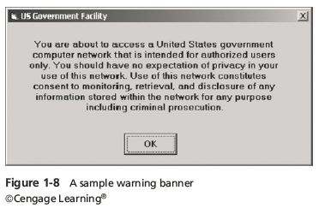
Understanding Private-Sector Investigations
Business can avoid litigation by displaying a warning banner on computer screens
  Informs end users that the organization reserves the right to inspect computer systems and network traffic at will
Notes:
Understanding Private-Sector Investigations
Business can avoid litigation by displaying a warning banner on computer screens
Informs end users that the organization reserves the right to inspect computer systems and network traffic at will
Figure 1-8 A sample warning banner

Slide 19
Understanding Private-Sector Investigations
Sample text that can be used in internal warning banners:
  Use of this system and network is for official business only
  Systems and networks are subject to monitoring at any time by the owner
  Using this system implies consent to monitoring by the owner
  Unauthorized or illegal users of this system or network will be subject to discipline or prosecution
Notes:
Understanding Private-Sector Investigations
Sample text that can be used in internal warning banners:
Use of this system and network is for official business only
Systems and networks are subject to monitoring at any time by the owner
Using this system implies consent to monitoring by the owner
Unauthorized or illegal users of this system or network will be subject to discipline or prosecution
If you agree to terms and connect to a network that is not your own private network, then they can do a remote data acquisition without your knowledge and consent.
For example: your umich email which is apart of the UM organization can search your email without your consent (through proper procedure).

Slide 20
Understanding Private-Sector Investigations
Businesses are advised to specify an authorized requester who has the power to initiate investigations
Examples of groups with authority
  Corporate security investigations
  Corporate ethics office
  Corporate equal employment opportunity office
  Internal auditing
  The general counsel or legal department
Notes:
Understanding Private-Sector Investigations
Businesses are advised to specify an authorized requester who has the power to initiate investigations
Examples of groups with authority
Corporate security investigations
Corporate ethics office
Corporate equal employment opportunity office
Internal auditing
The general counsel or legal department

Slide 21
Understanding Private-Sector Investigations
During private investigations, you search for evidence to support allegations of violations of a company’s rules or an attack on its assets
Three types of situations are common:
  Abuse or misuse of computing assets
  E-mail abuse
  Internet abuse
A private-sector investigator’s job is to minimize risk to the company
Notes:
Understanding Private-Sector Investigations
During private investigations, you search for evidence to support allegations of violations of a company’s rules or an attack on its assets
Three types of situations are common:
Abuse or misuse of computing assets
E-mail abuse
Internet abuse
A private-sector investigator’s job is to minimize risk to the company

Slide 22
Understanding Private-Sector Investigations
The distinction between personal and company computer property can be difficult with cell phones, smartphones, personal notebooks, and tablet computers
Bring your own device (BYOD) environment
  Some companies state that if you connect a personal device to the business network, it falls under the same rules as company property
Notes:
Understanding Private-Sector Investigations
The distinction between personal and company computer property can be difficult with cell phones, smartphones, personal notebooks, and tablet computers
Bring your own device (BYOD) environment
Some companies state that if you connect a personal device to the business network, it falls under the same rules as company property
So for example: company may force you to update the computer so they do not have a compromised entry point to the network.
Also, for example, UM wifi is a special entry point with extra layers of security between the wifi network and the internal organizational network.
The difference between personal and company data is rather ambiguous on company property or even if a BYOD device is on the company network; so it is relatively easy and legal for them to acquire your data for investigation.

Slide 23
Maintaining Professional Conduct
Professional conduct - includes ethics, morals, and standards of behavior
An investigator must exhibit the highest level of professional behavior at all times
  Maintain objectivity
  Maintain credibility by maintaining confidentiality
Investigators should also attend training to stay current with the latest technical changes in computer hardware and software, networking, and forensic tools
Notes:
Maintaining Professional Conduct
Professional conduct - includes ethics, morals, and standards of behavior
An investigator must exhibit the highest level of professional behavior at all times
Maintain objectivity
Maintain credibility by maintaining confidentiality
Investigators should also attend training to stay current with the latest technical changes in computer hardware and software, networking, and forensic tools

